Slide 1

Land Record Management System Using Blockchain
Jawad Ahmed
Sharjeel Akram
Mian Muhammad Zubair
Supervisor: Mr. Adnan Bashir
Co-Supervisors: Fareed ul Hassan, Ihsan Elahi Butt

Slide 2
Agenda
Introduction
01
Here we will talk about the background, objectives and scope
Literature Review
02
Here we will talk about the related work and some research in land management system.
Analysis and Design
03
Here we will talk about the class diagram, flow chart, block diagram, Use case diagram.
Technology and Databases
04
Here we will talk about the technology, database uses in the project.
Working Prototypes
05
Here we will talk about the interfaces and pseudo code.
.

Slide 3
Introduction
Problem Statement
Corruption and fraud in record keeping
Benefits of Blockchain
Objective
Immutable and secure ledger that can prevent fraud and tampering
To implement blockchain-based land management system for secure and efficient land transactions.
Lack of transparency in land ownership and transfer
Disputes and delays in land transactions
Transparent record-keeping that can reduce disputes and delays
Decentralized system that eliminates the need for intermediaries
To evaluate system performance, usability, and safety through tests and simulations.
To increase transparency, decreased transaction costs, and improved data accuracy and integrity
Traditional approach for storing land data
Centralized System

Slide 4
"Blockchain for Land Administration" by Peter van Oosterom and Jantien Stoter (2018):
Blockchain can provide an immutable and transparent record of land ownership
"Blockchain-Based Land Registry: Case Studies and Analyses" by Gabriel Alfonso Otero and José Manuel Sáez López (2019):
A Smart Contract Approach in Pakistan Using Blockchain for Land Management by Muhammad Idrees, PUCIT May 2022
Blockchain can allow for a decentralized and peer-to-peer network for land transactions, reducing the power of centralized authorities and intermediaries
The decentralized and tamper-resistant nature of blockchain technology can improve the security of land records, reducing the risk of corruption and fraud.
Smart contracts can automate the process of land sales, purchases, and transfers
Technical challenges: The implementation of blockchain-based land administration systems requires significant technical expertise
By reducing the need for intermediaries and paperwork, the proposed system can reduce transaction costs associated with land management.
Resistance to change: The adoption of a blockchain-based land management system may face resistance from established stakeholders who may be reluctant to change their traditional methods of operation.
Legal and regulatory challenges: The legal and regulatory frameworks for land registry systems vary widely across different countries and regions
Literature
Review

Slide 5
Related
Work
Sweden and Georgia
Both have established blockchain-based land registry systems to increase the efficiency and transparency of land transactions, which are examples of relevant work in the sector.
Ghana and Honduras
Related Work In Pakistan
These countries have developed blockchain-based land title systems to address issues related to land tenures, such as insecure land rights and disputes over land ownership.
Some of the research work conducted in Pakistan but they mostly work on the land network, they do not connect the backend like node express with the Hyperledger fabric network.

Slide 6
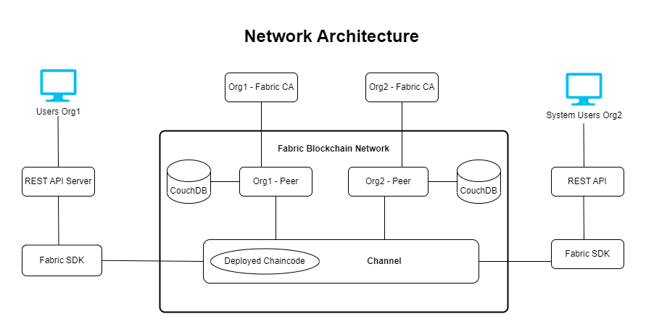
Diagram
Fig 1: Network Architecture

Slide 7
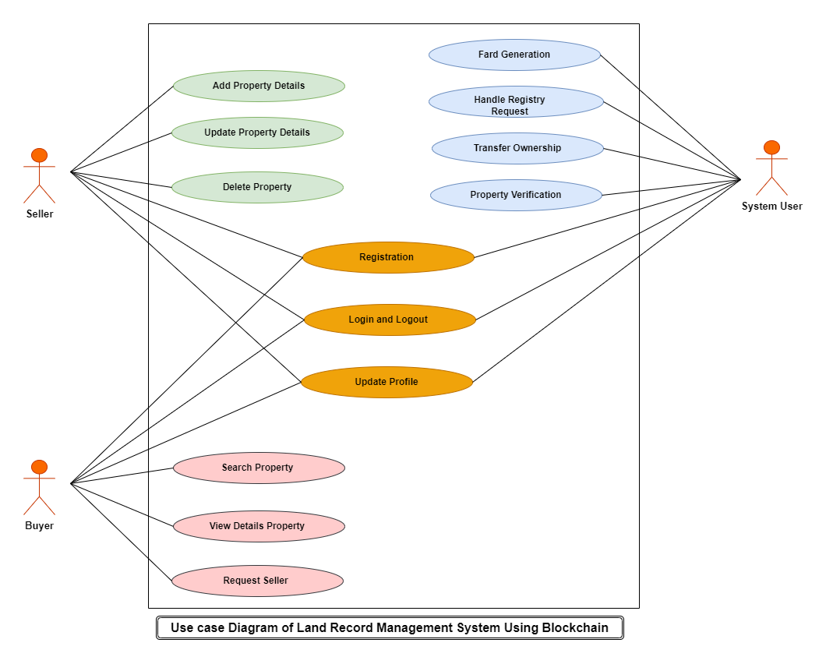
Diagram
Fig 2: Use Case Diagram

Slide 8
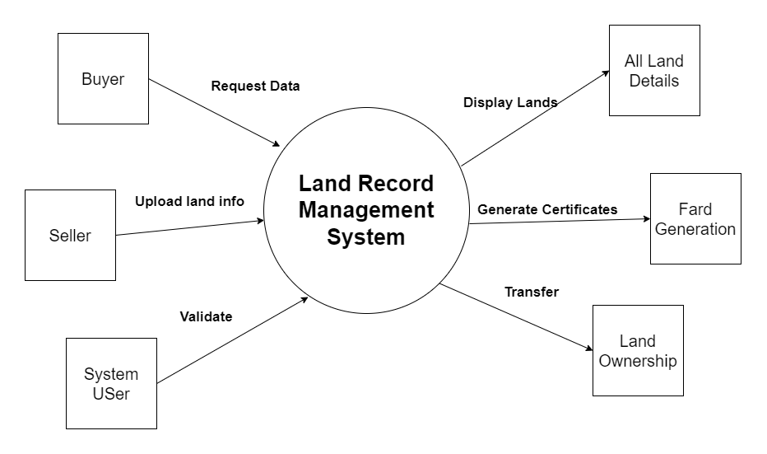
Diagram
Fig 3: Context Level DFD

Slide 9
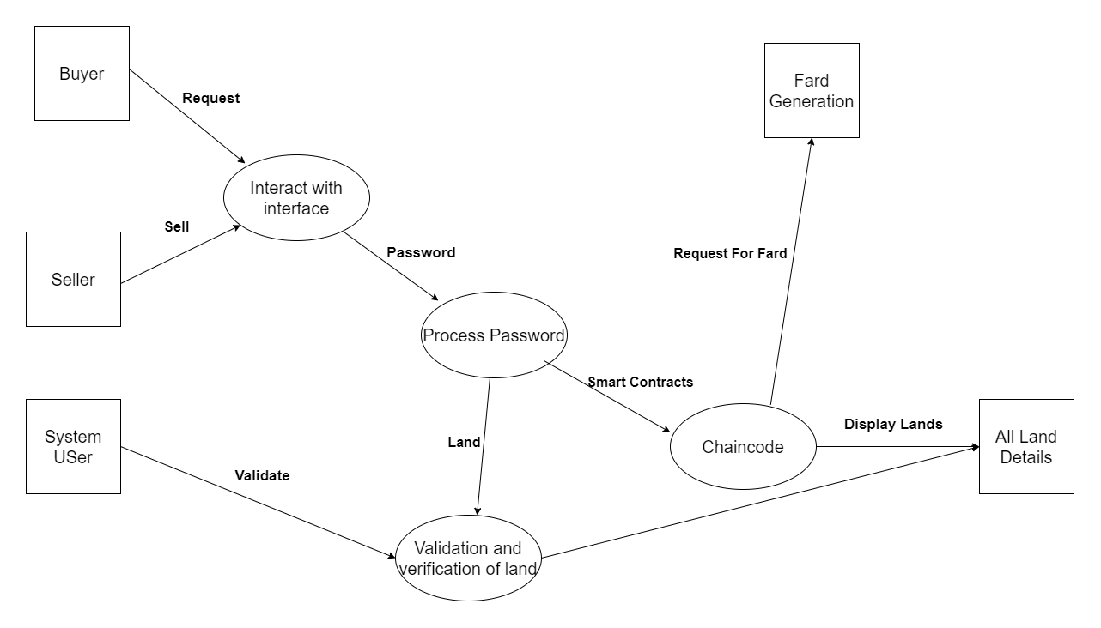
Level 1 DLD Diagram
Fig 4: Level 1 DFD

Slide 10
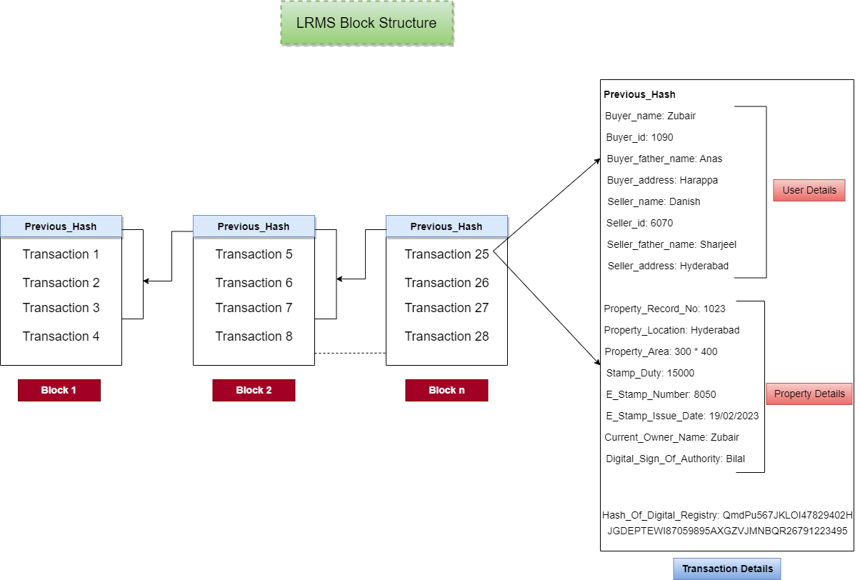
Diagram
Fig 5: Block Structure Diagram

Slide 11
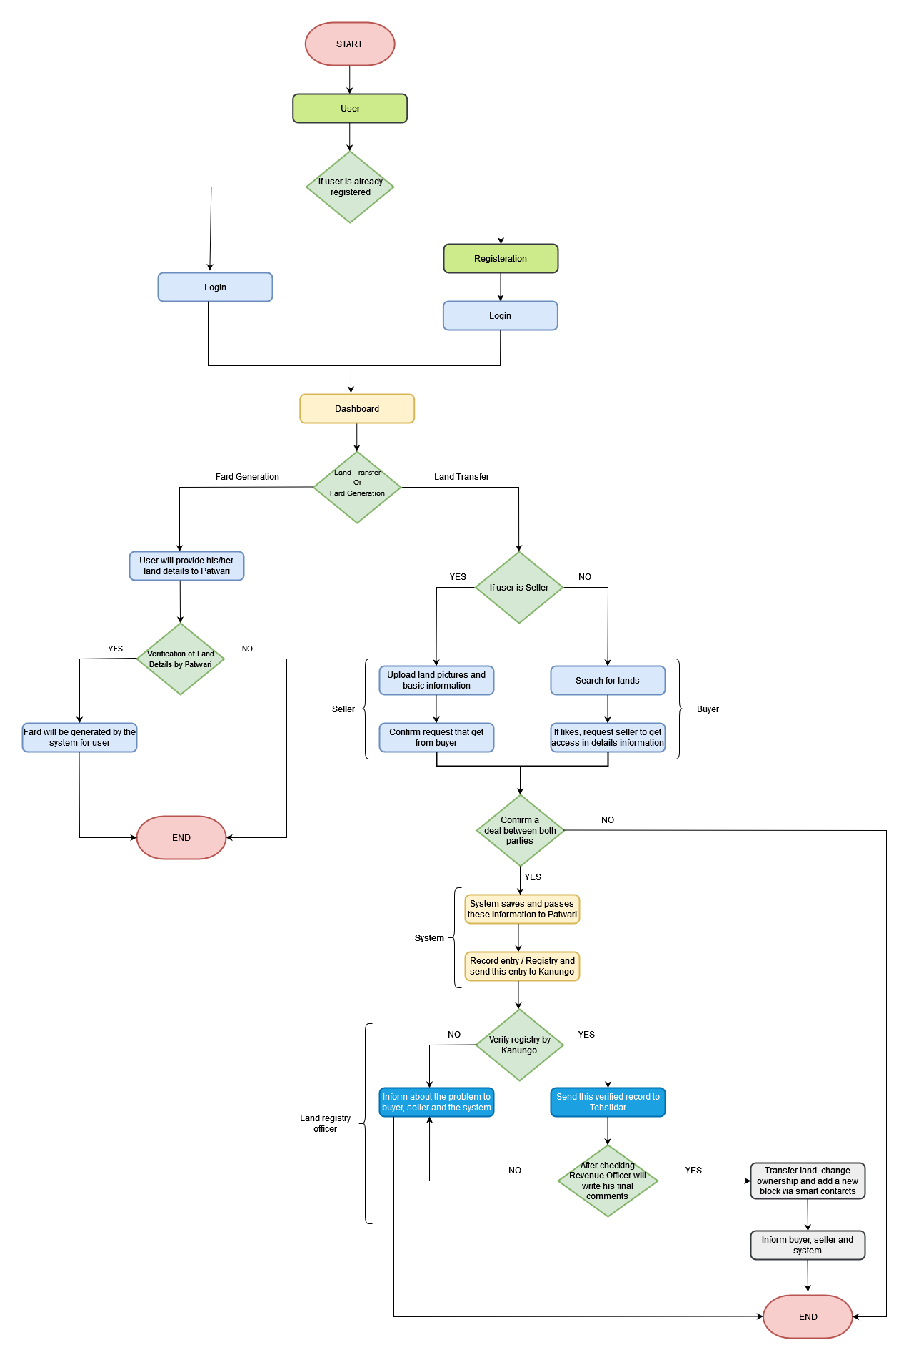
Diagram
Fig 6: Flow Chart

Slide 12
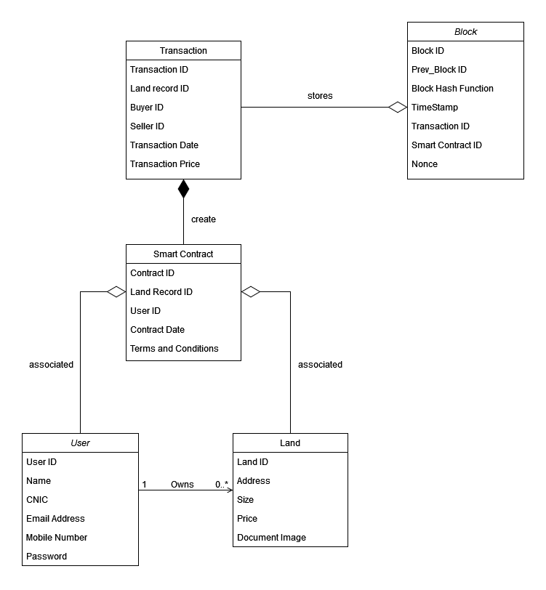
Class Diagram
Fig 7: Class Diagram

Slide 13
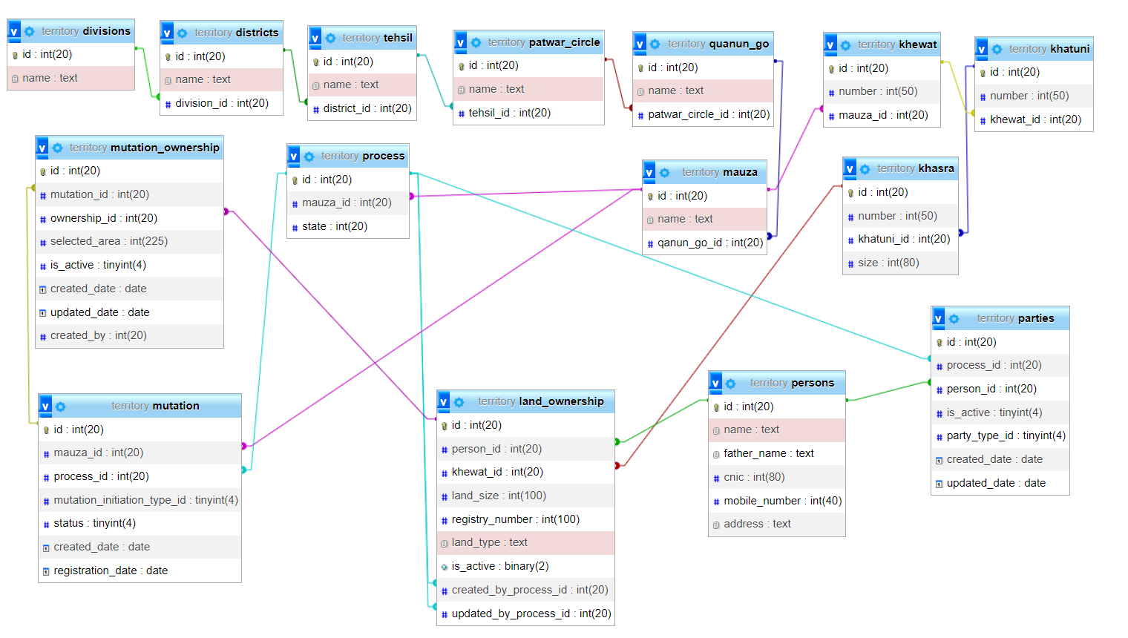
ERD
Fig 8: ERD

Slide 14
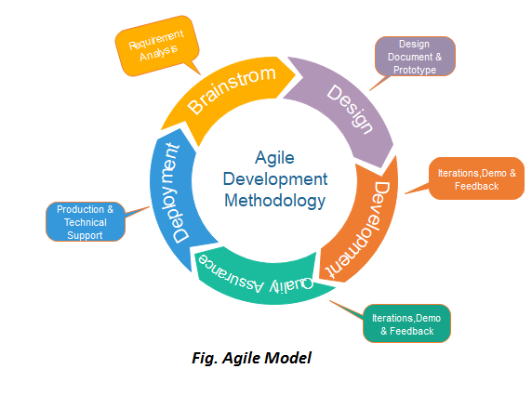
Software Process
Reference: https://www.javatpoint.com/software-engineering-agile-model

Slide 15
Technology
Hyperledger Fabric:
Rather than an open, permission-less system, Fabric offers a scalable and secure platform that supports private transactions and confidential contracts.
Docker
Pull Hyperledger fabric images
Database
CouchDB For Transactional Data
Use docker containers
Using it as a local machine server to run the system
Database is being store in the container images i.e couchdb
SQL For Storing Land Data

Slide 16
Technology
Smart Contracts
Chaincode is a smart contract in the Hyperledger Fabric framework that enables the execution of business logic on the blockchain.
Node Express
Node working as a server
For frontend we are using html in ejs templates
For backend we use Express JS
In the land record management system, chaincode can be used to define the rules and regulations for transactions related to land ownership, transfer, and management.
Chaincode can be used to automate the execution of contracts between buyers and sellers, as well as other stakeholders, such as government agencies.
In this project we write the chaincode in the JavaScript.

Slide 17
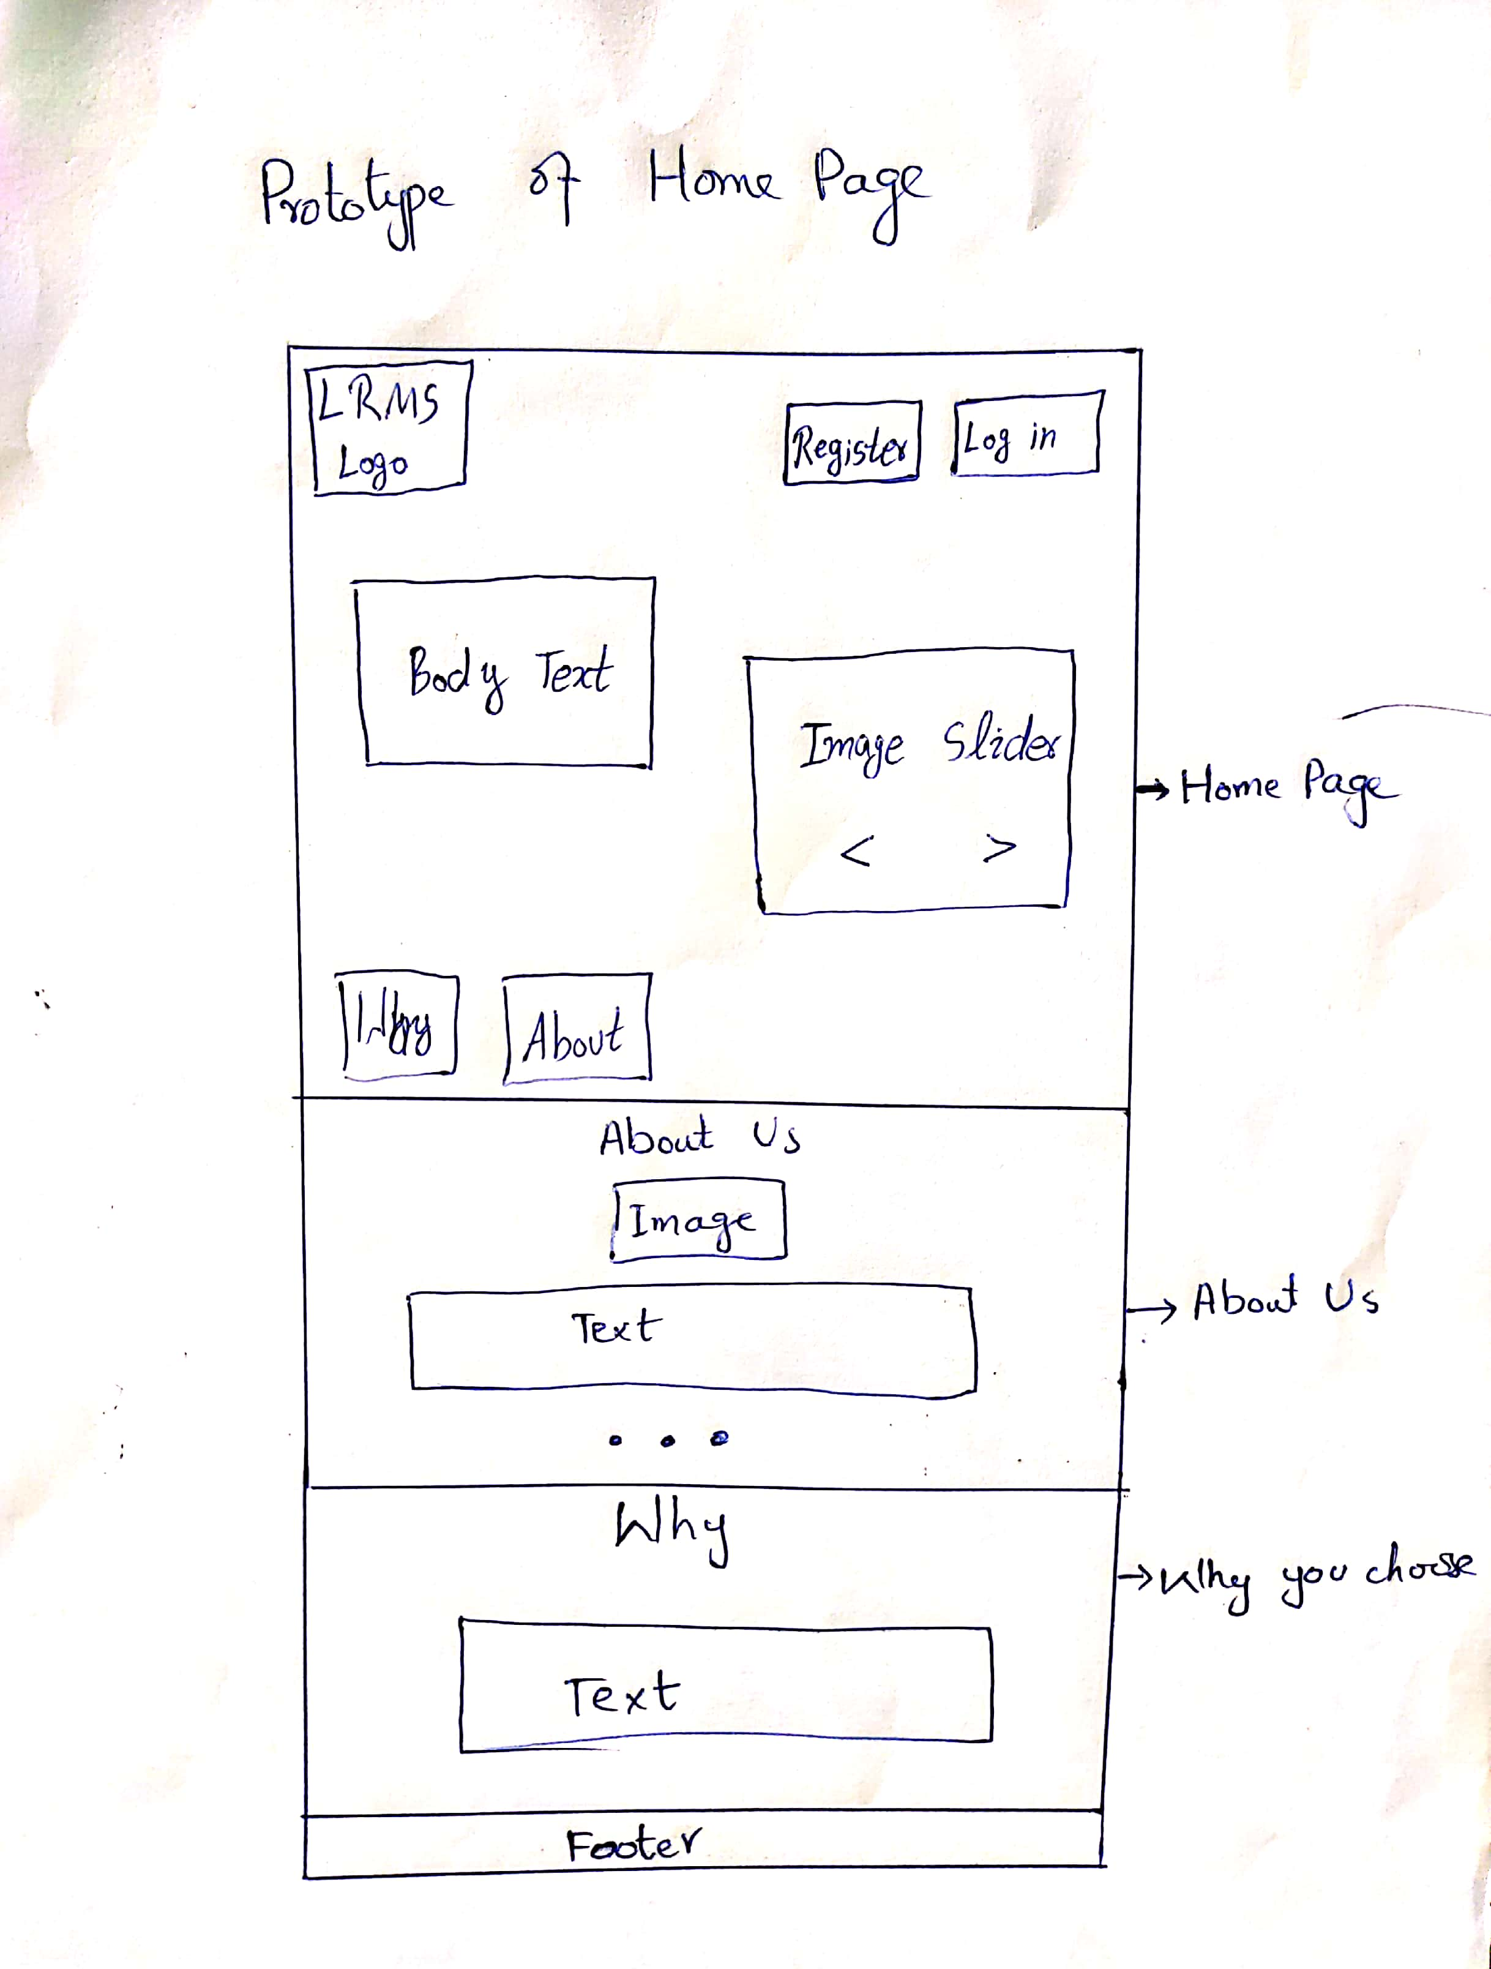
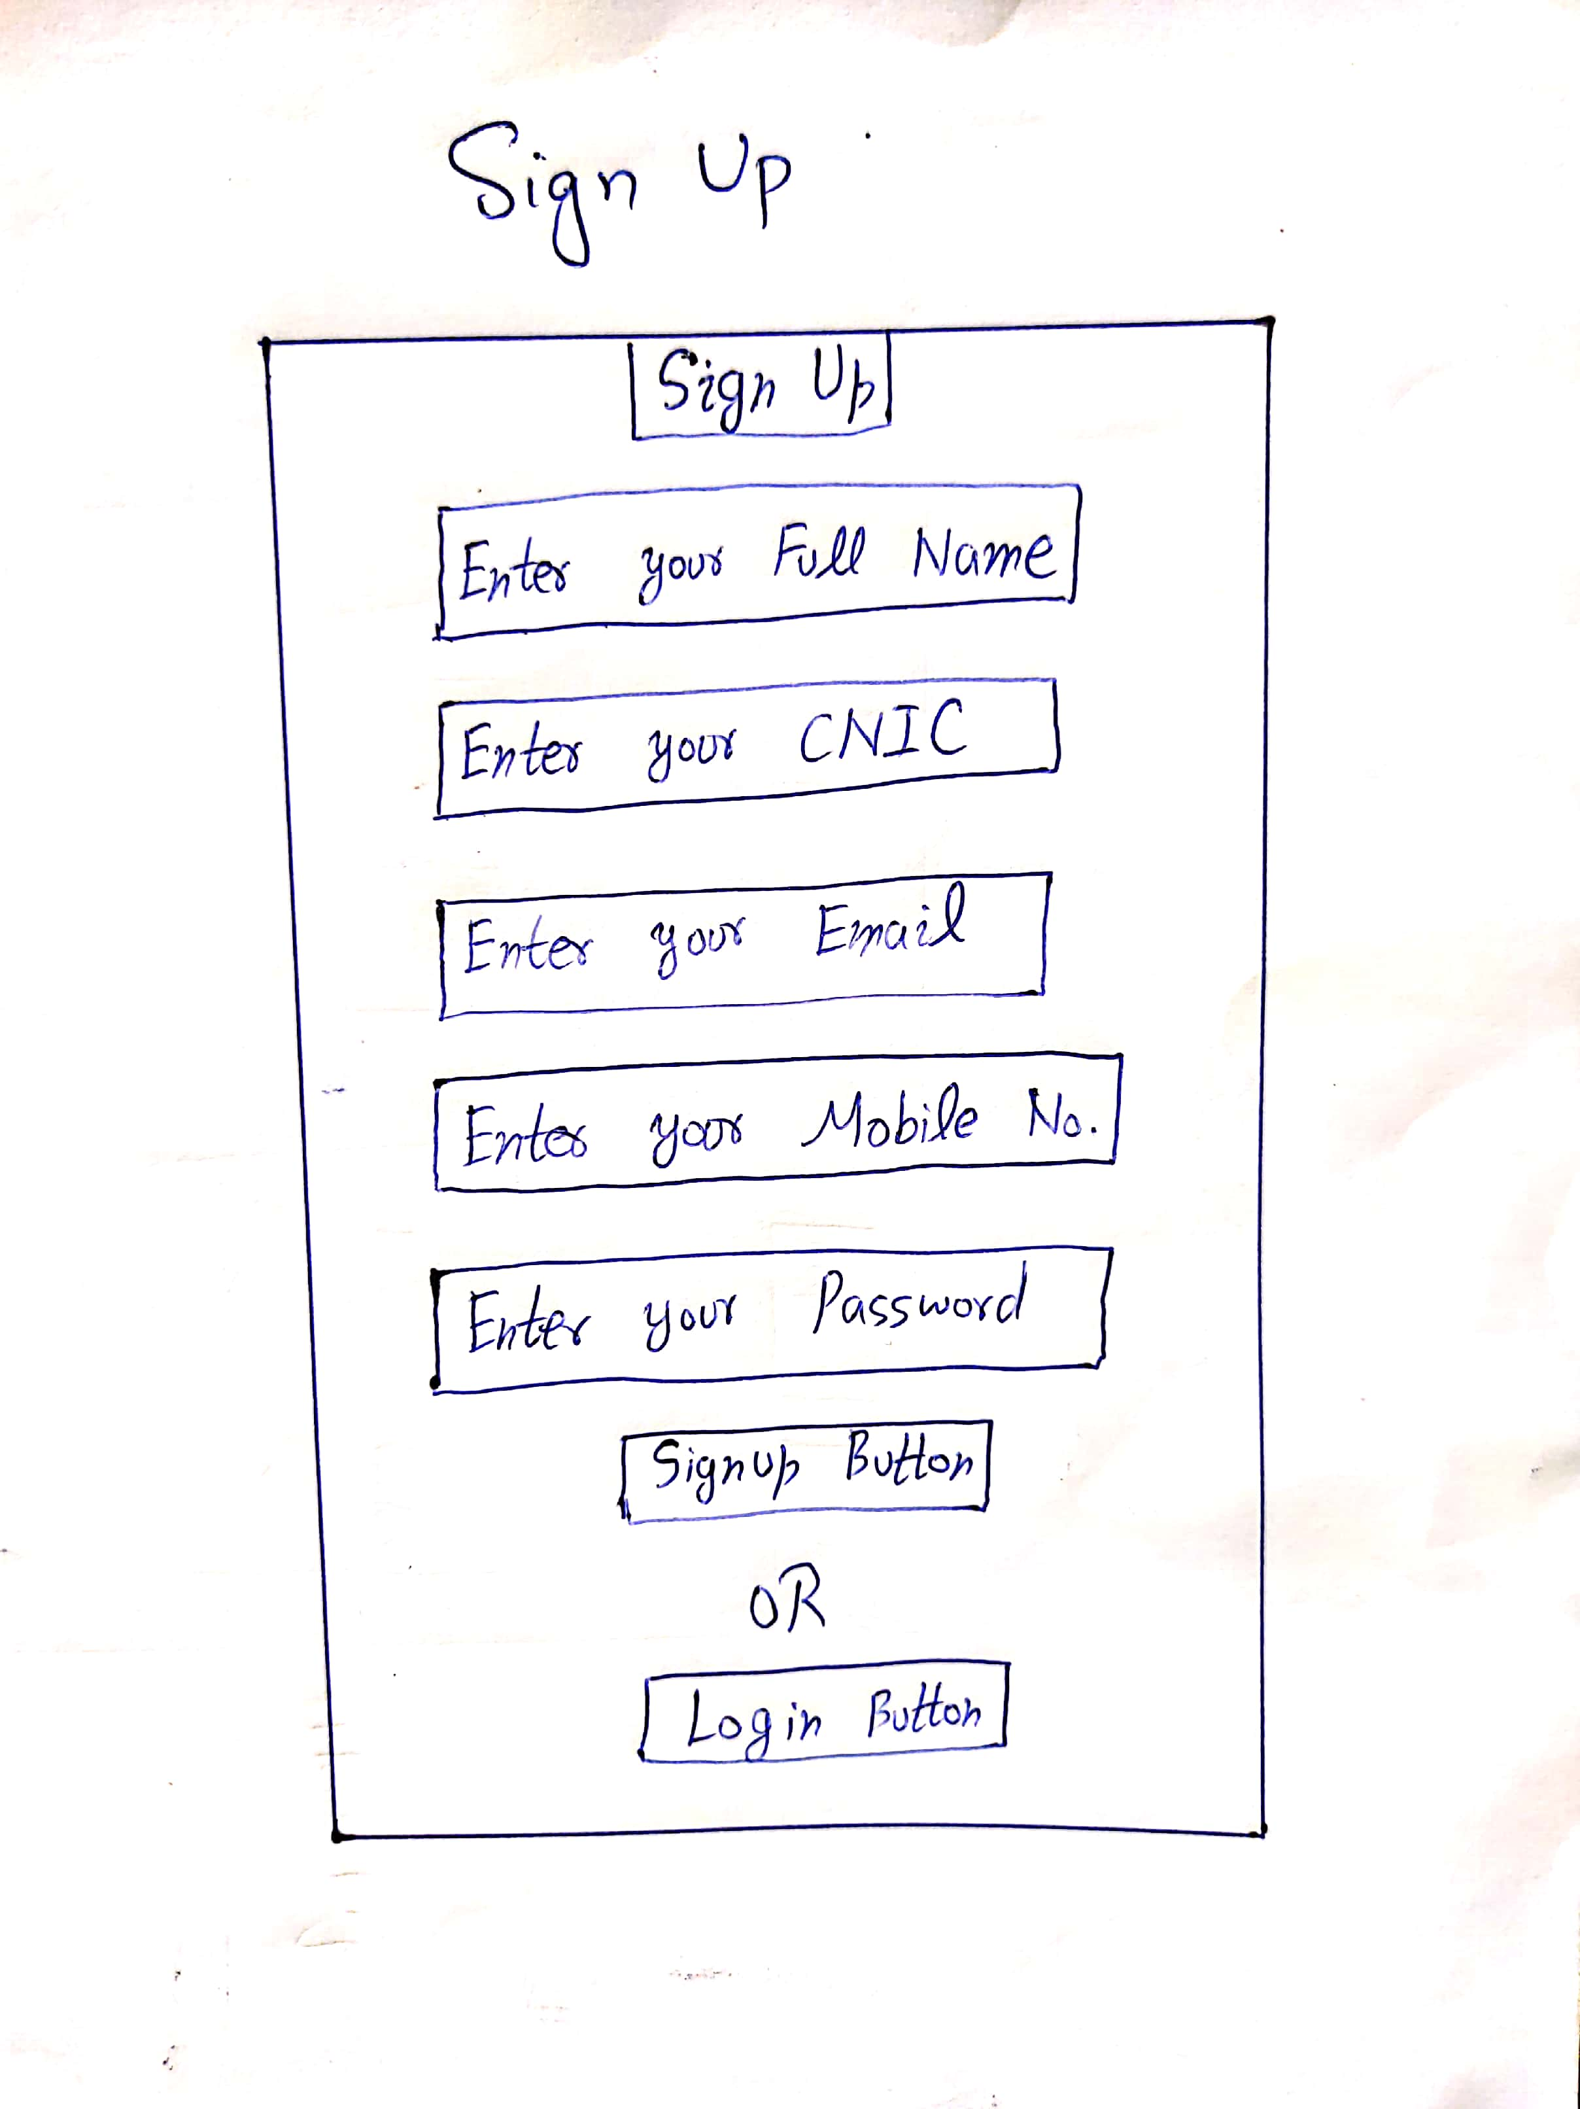
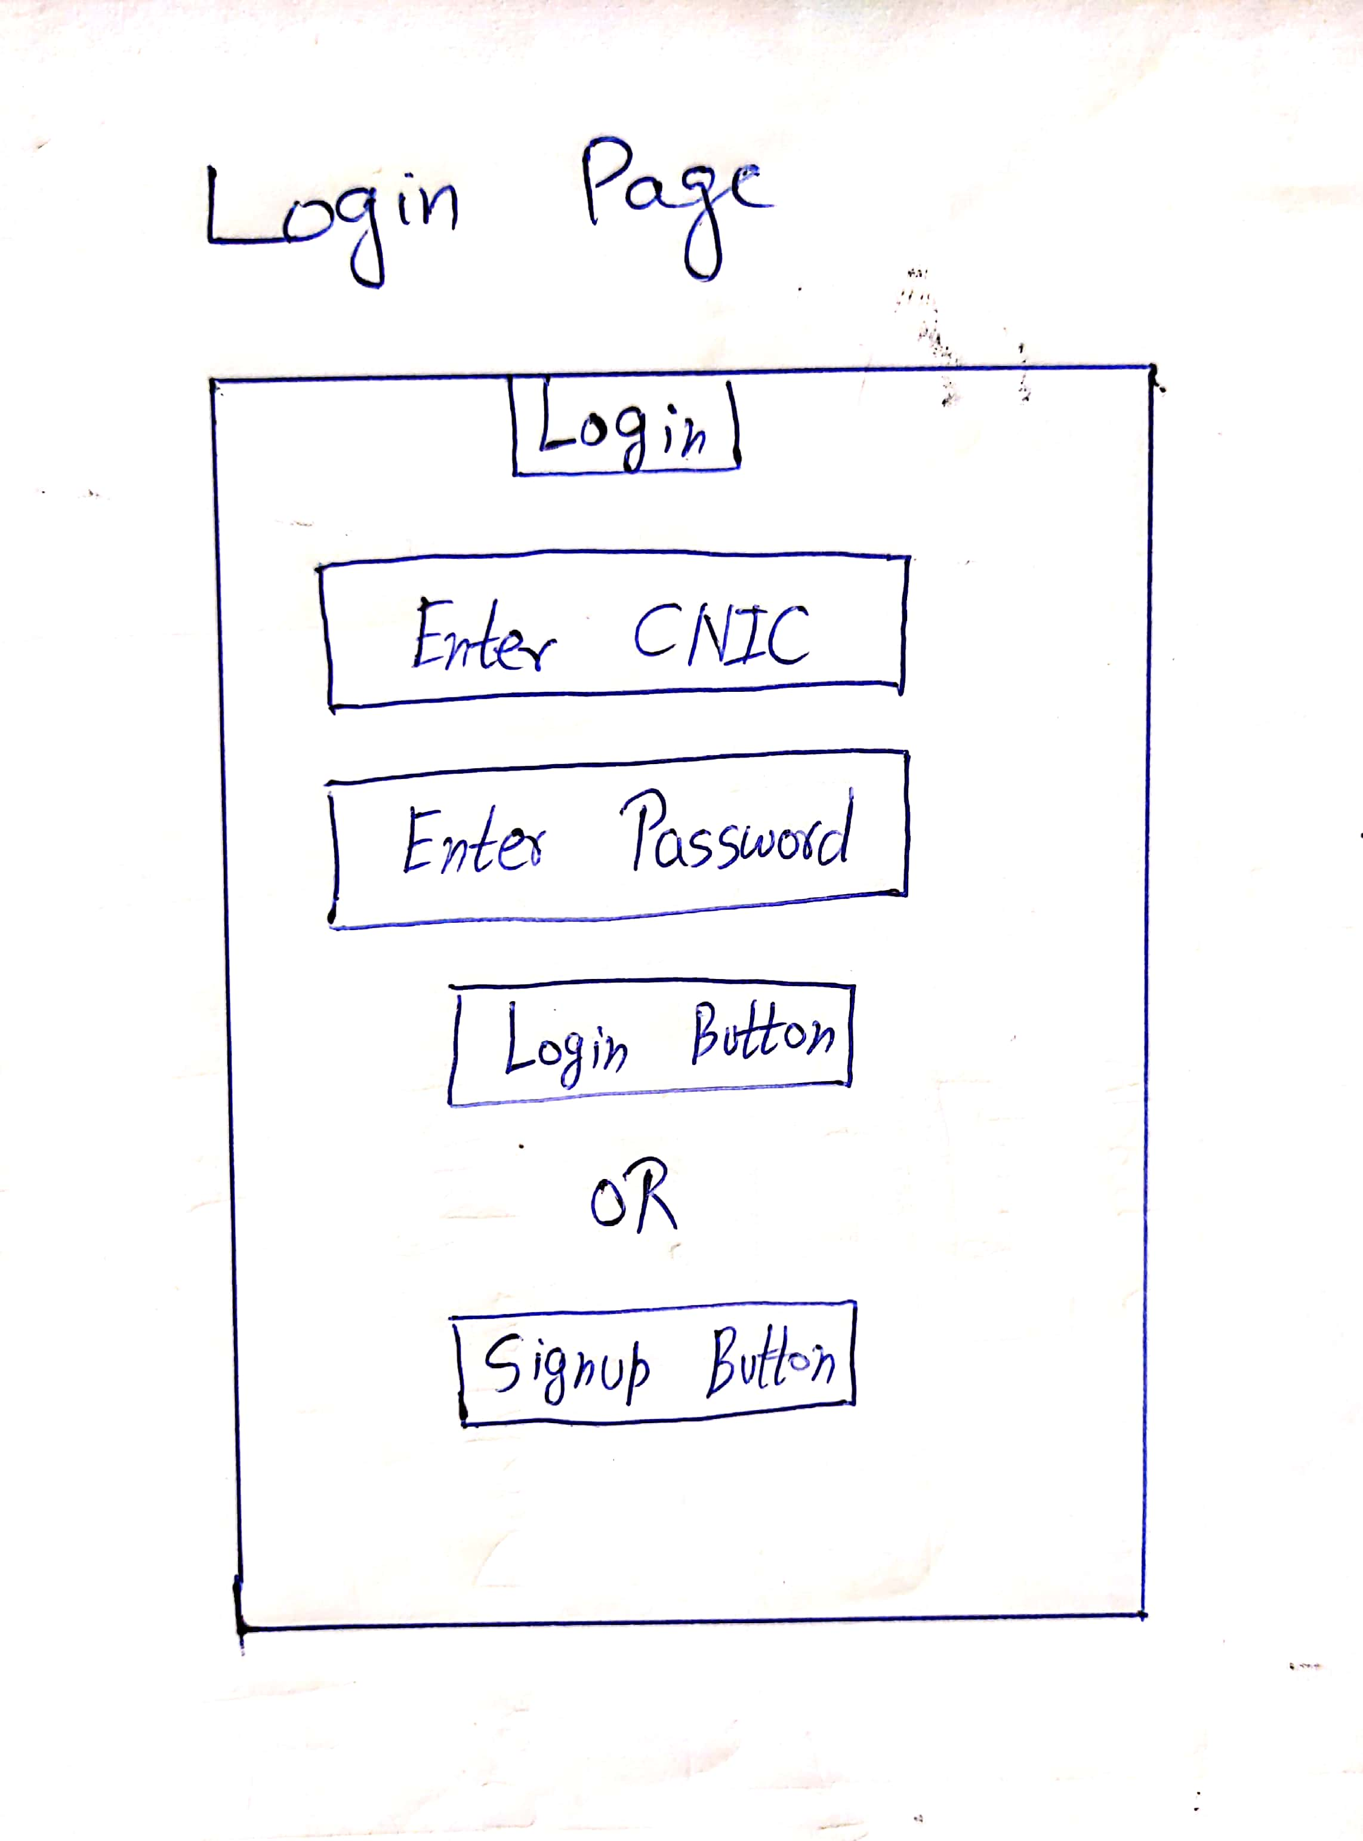
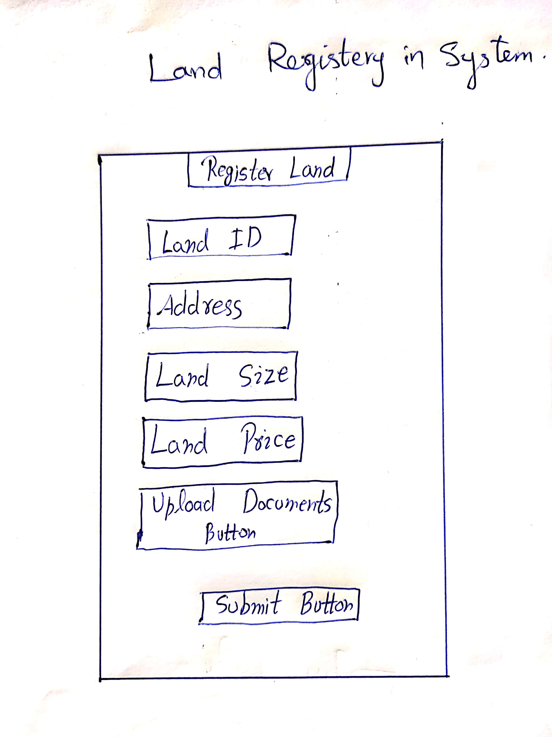
Prototype

Slide 18
Remaining Work
Uploading and Verification of Documents
Fard Generation
Implementation of System Users
Transfer Of Land Ownership

Slide 19
Project Demo
Land Record Management System

Slide 20

Thank You

Slide 21
References
1. https://medium.com/bitcoinblase/blockchain-application-land-register-georgia-and-sweden-leading-e7fa9800170c
2. https://www.oecd.org/corruption/integrity-forum/academic-papers/Georg%20Eder-%20Blockchain%20-%20Ghana_verified.pdf

